Slide 1

Data Structures Fundamentals (with C#)
Course Introduction
SoftUni Team
Technical Trainers
Software University
https://softuni.bg/

Slide 2
Table of Contents
Course Objectives
Training and Team
Course Organization
Course Infrastructure
Evaluation Criteria

Slide 3
Have a Question?
sli.do
#ds-csharp

Slide 4

Course Objectives

Slide 5
Course Objectives
Working with data structures and analyze algorithmic complexity
Implementing data structures
Comparison between similar operations
in different data structures
Building solid knowledge base on data storage implementation details and optimization problems in real time environment

Slide 6
Practical Programming Exam
Exam
3 practical problems for four hours
Linear Data Structures
Basic Trees
Breath First Search, Depth First Search
Heaps
BST
Everything included in the course

Slide 7
Theoretical Exam
You will have 30 minutes once you enter
20 questions with:
Multiple choice with only one correct answers
English
Automated quiz system
Available online at the day and time of the practical exam
You can submit your answers just once

Slide 8

The Team

Slide 9
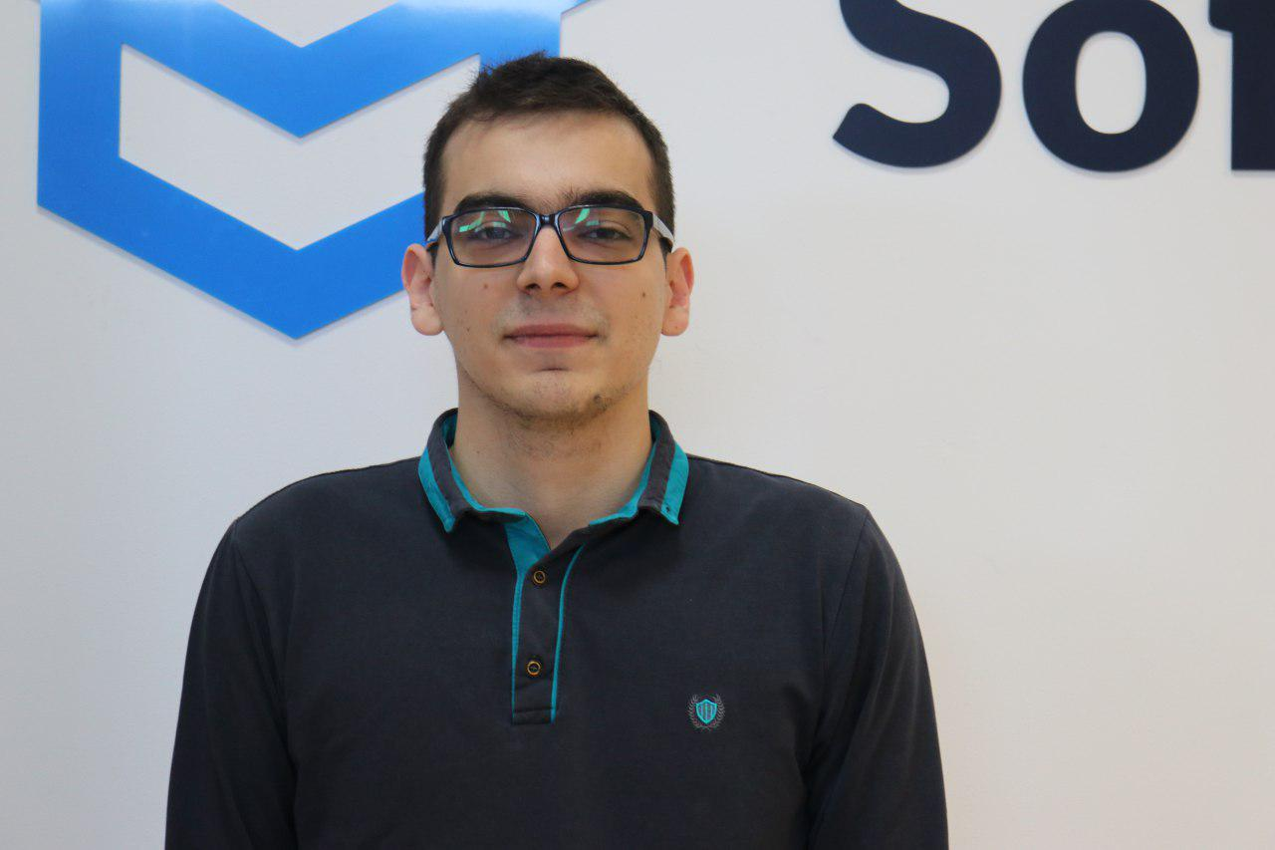
Kiril Kirilov
Technical Trainer @ SoftUni
Worked as a Front-End Developer
Passionate about .NET, JavaScript, Angular
Currently studying Math & Informatics at Sofia University (FMI)
Contacts:
k.kirilov@softuni.bg

Slide 10

Course Organization

Slide 11

Homework Assignments & Exercises
Your homework:
Lesson days → slides + live demos + exercises + tests
How to submit your homework?
For practical problems: Submitted in the judge system
For tests https://quiz.softuni.bg/
Do your homework when it's due
Assignments pile up quickly

Slide 12


Scoring System for the Course
Theoretical Exam 5%
Practical Exam 95%
Bonus Homework 5 %
Evaluation

Slide 13



Course Web Site, Forum and FB Group
Official web site:
Official discussion forum:
Official Facebook group:
https://softuni.bg/trainings/2812/data-structures-fundamentals
https://softuni.bg/forum
https://www.facebook.com/groups/DataStructuresFundamentalswithCSharpSeptember2020/

Slide 14
Questions?
Notes:
14

Slide 15












SoftUni Diamond Partners

Slide 16




SoftUni Organizational Partners

Slide 17




Trainings @ Software University (SoftUni)
Software University – High-Quality Education and Employment Opportunities
softuni.bg
Software University Foundation
http://softuni.foundation/
Software University @ Facebook
facebook.com/SoftwareUniversity
Software University Forums
forum.softuni.bg

Slide 18

License
This course (slides, examples, demos, videos, homework, etc.) is licensed under the "Creative Commons Attribution-NonCommercial-ShareAlike 4.0 International" license

